Slide 1
Why try Morea?

Slide 2
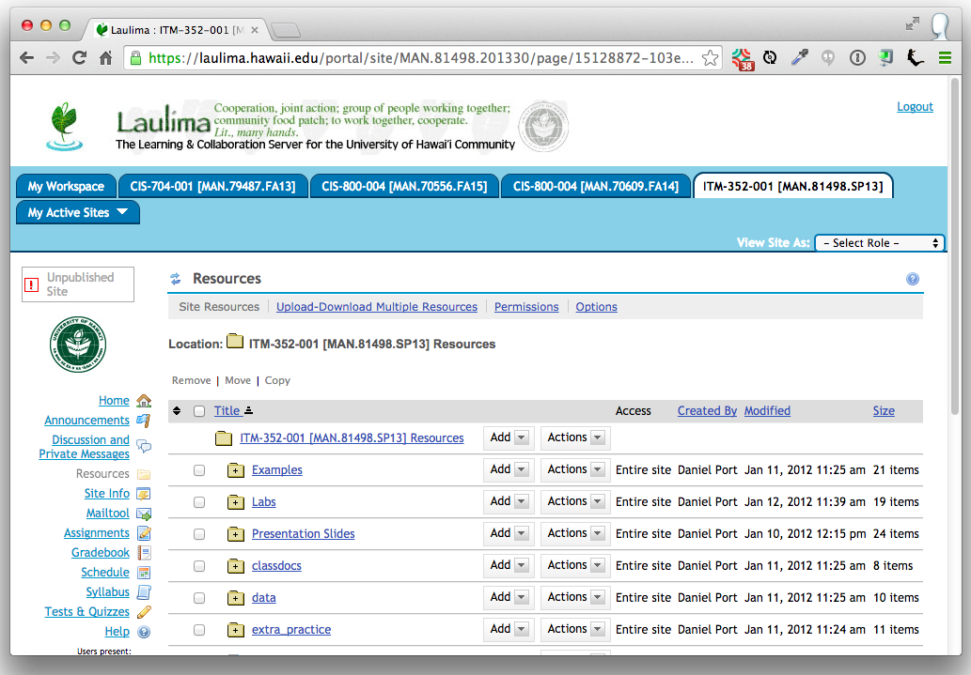

Slide 3
walled
garden

Slide 4
old fashioned
UX

Slide 5
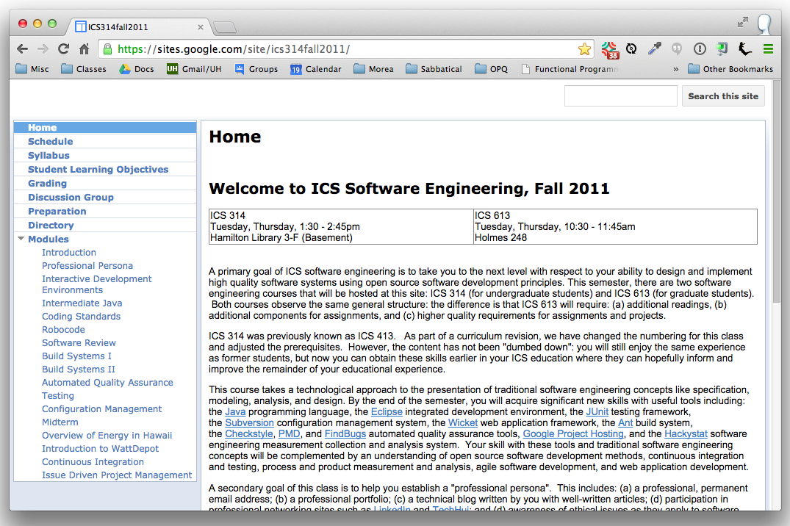

Slide 6
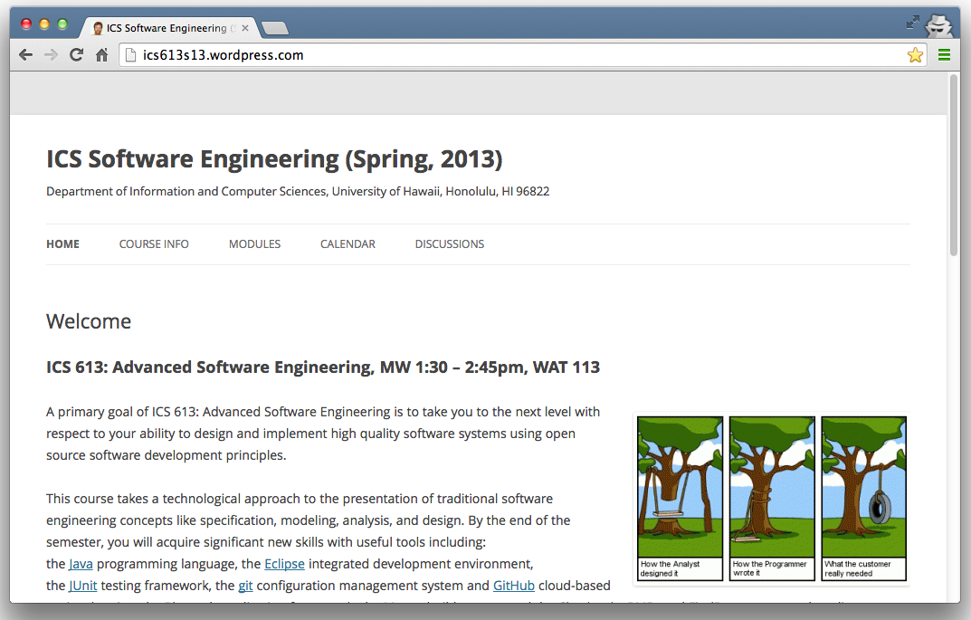

Slide 7
hard to reuse

Slide 8
hard to change

Slide 9
walled garden old fashioned UX hard to reuse hard to change
Negative requirements
NOT

Slide 10
Better represent intent: Why learn it? What to learn? When to learn it? How to learn it?
Positive requirements

Slide 11
Module Outcome Reading Experience Assessment
A skeletal structure for course content

Slide 12
Morea is not a black box
You are not insulated from the
underlying technologies

Slide 13




pages
hosting
markdown
git
Jekyll
GitHub
Bootstrap
Morea
UI
Jekyll plugin shell scripts
themes

Slide 15
Outcomes w/o assessments Assessments w/o outcomes Modules w/o outcomes Modules w/o assessments Modules w/o experiences
Morea reveals course “smells”

Slide 16
Outcomes w/ multiple assessments Assessments w/ multiple outcomes Outcomes across multiple modules
Morea reveals cross-cutting concerns

Slide 17
git shell scripts cloud hosting gh-pages markdown installing ruby installing python jekyll yaml
contraindications

Slide 18
If you share my frustrations To better represent your intent If the tech does not scare you
Why try Morea?

